Slide 1
Project 2

Slide 2
Member names
Aditi Awasthi
Eleanor Prashamsini
Pragnya Suresh
Paras Naren
Myna P
Harshith Arun Kumar

Slide 3
Project-2
Steps:
0. Establishing Adhoc network
Name the server, assign static IP addresses, change wallpaper
One target server with one initiator
Two virtual hard disks from target, to same initiator
Mirror volume using both vhds
Remove one of the vhd
Add new vhd from target and make mirror healthy again

Slide 4
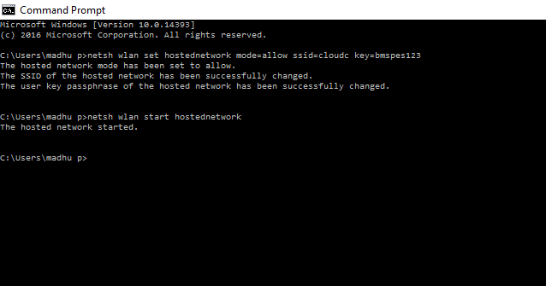
0. Establishing adhoc network

Slide 5
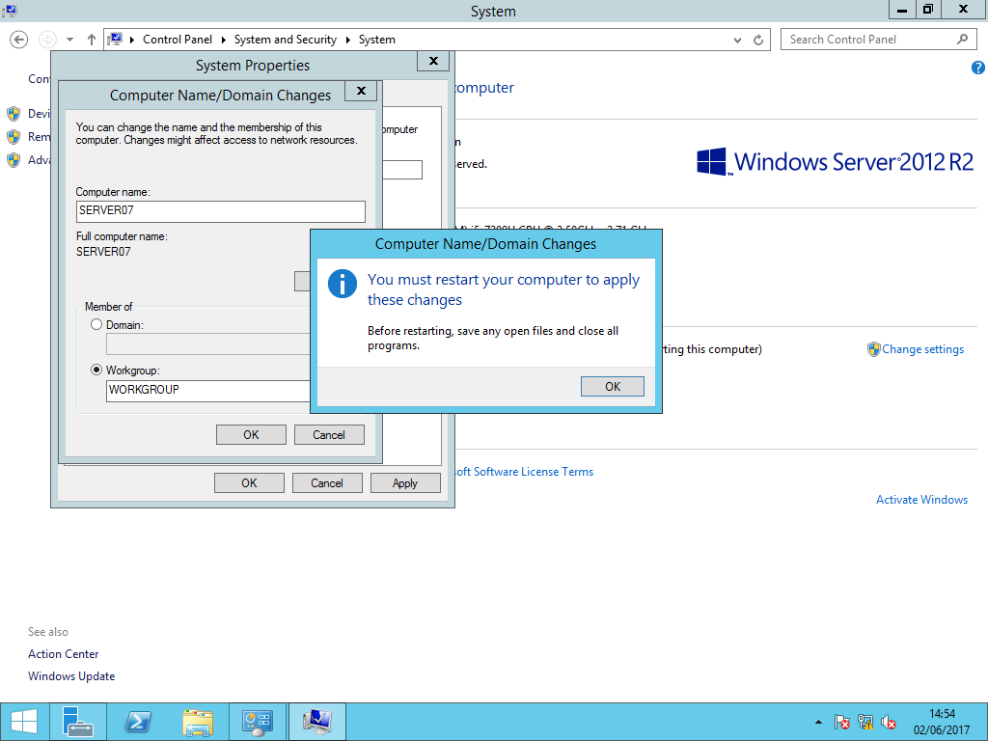
1. Changing Name of Server

Slide 6
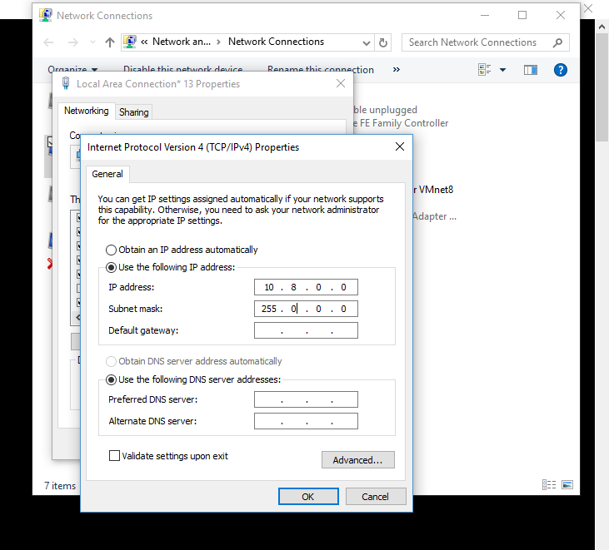
Changing IP of host
Network Connections → Local Area Connection Properties → change IPv4 address to 10.8.0.0

Slide 7
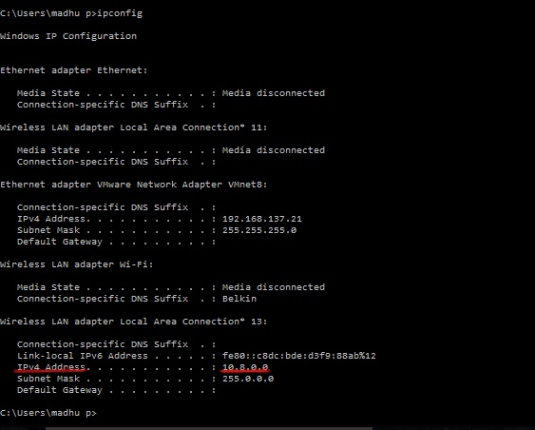
Changed ip of host

Slide 8
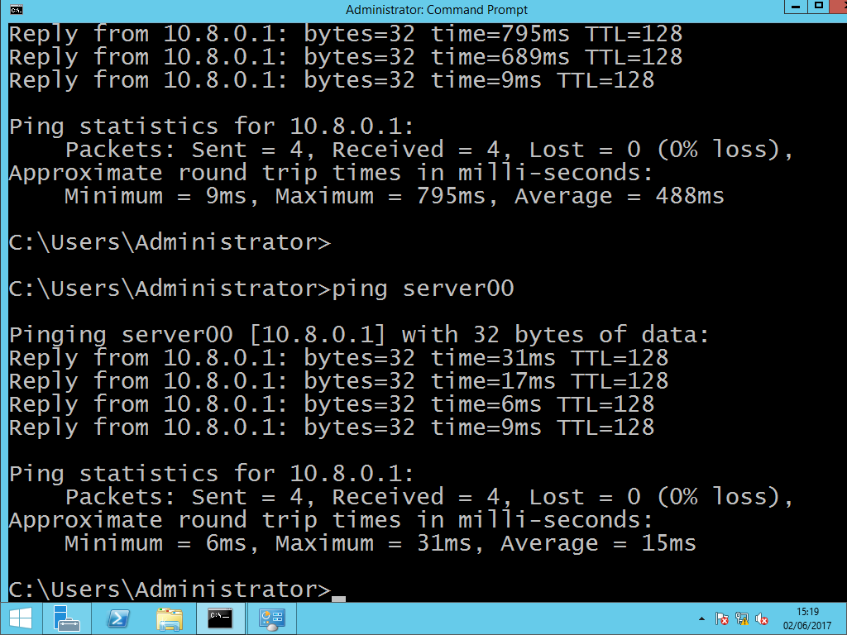
(Change of name taking into effect)

Slide 9
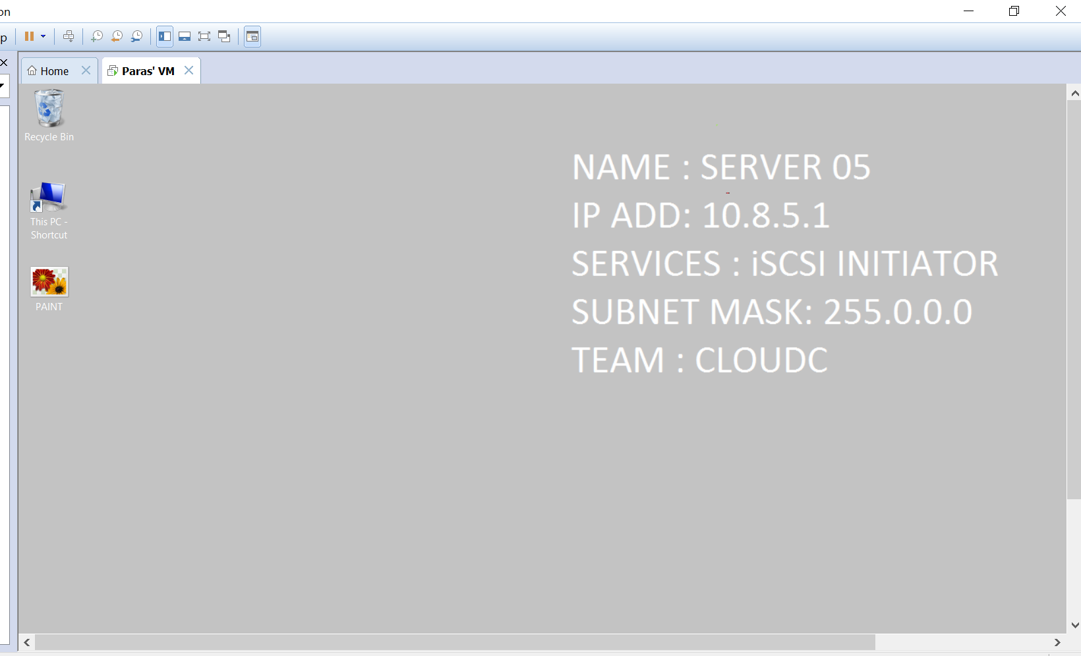
Wallpaper Change

Slide 10
Step 2- One target and one initiator
Involves two steps,
A) Target Setup
B) Initiator Setup
The target and Initiator are setup on two different computer systems, then linked through an Adhoc Network to facilitate the use of SAN (Storage Area Network)

Slide 11
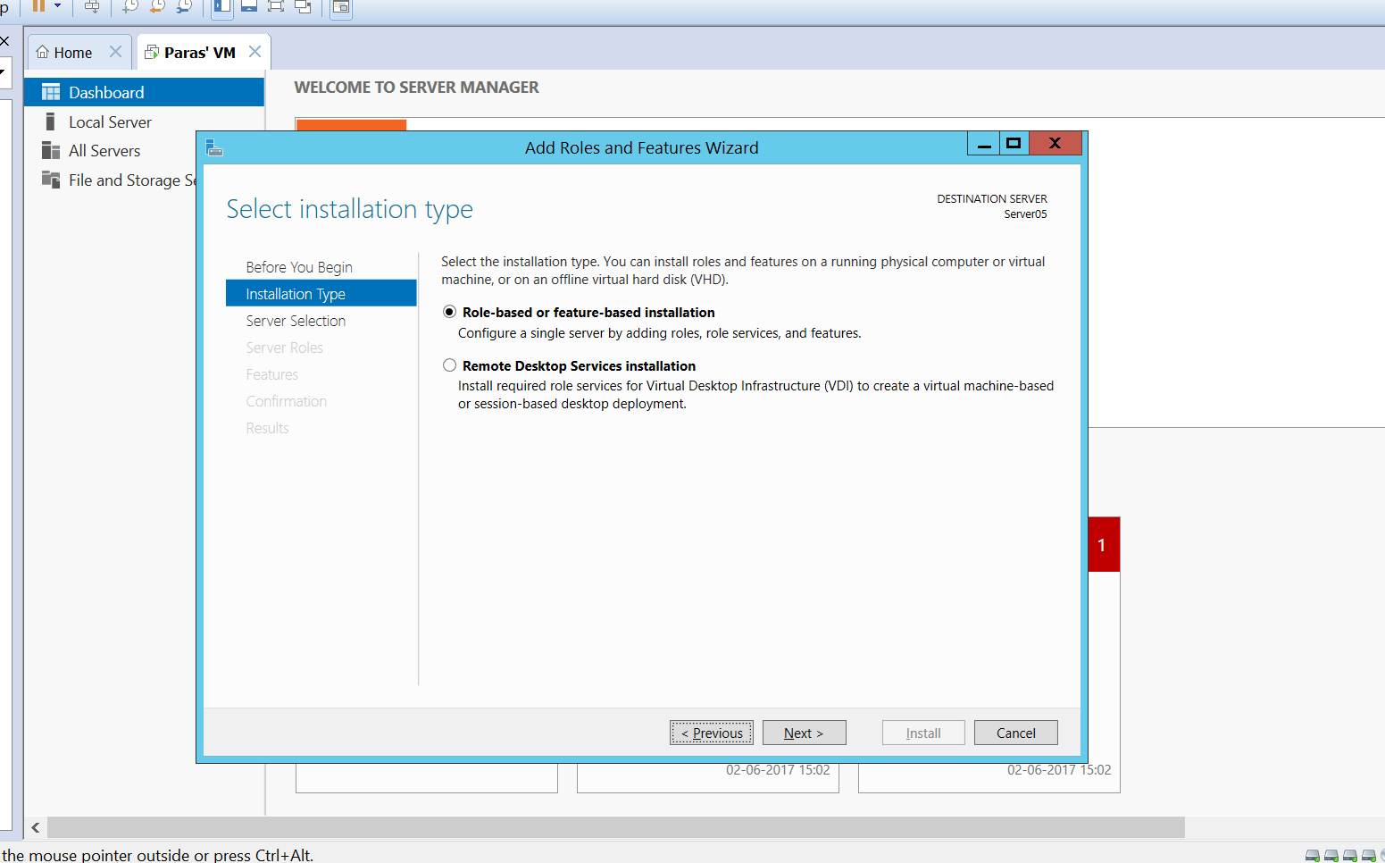
A) Target Setup
Under Server Manager this option is found

Slide 12
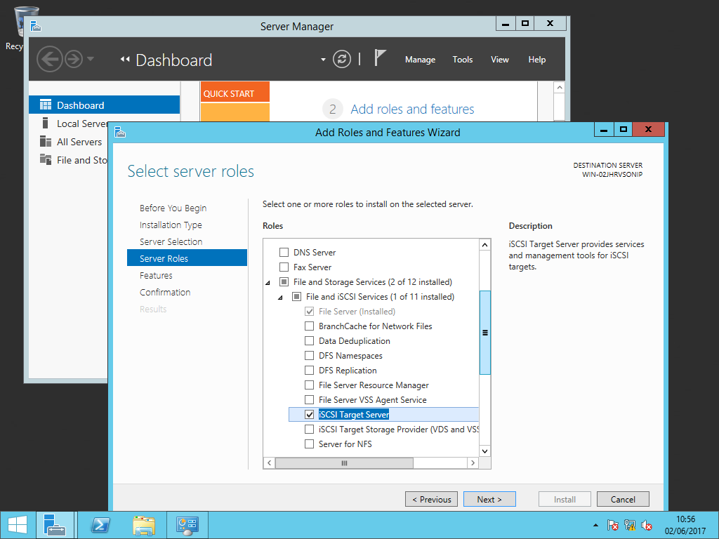
iSCSI Target Server is selected to be created

Slide 13
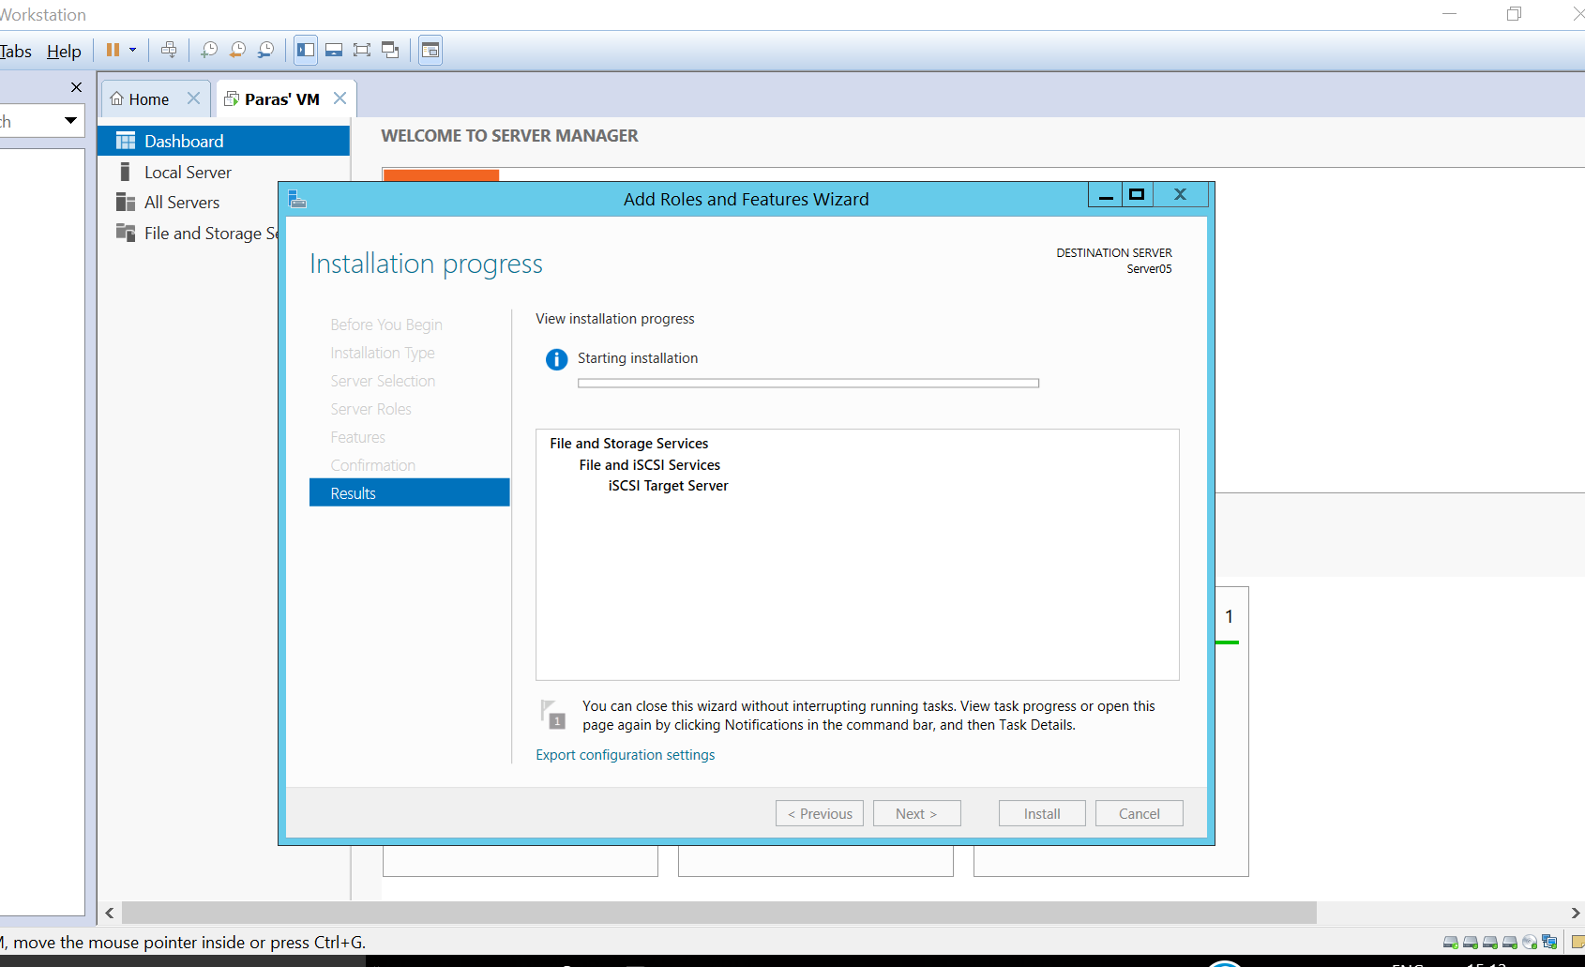
After following steps, completing the installation process

Slide 14
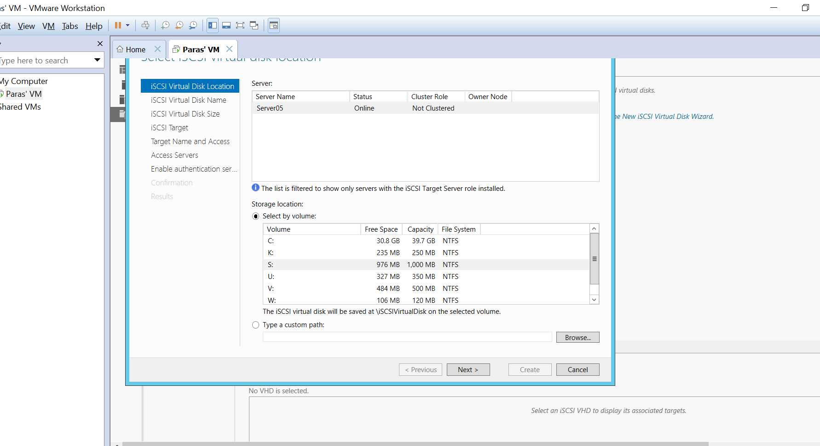
After installation of iSCSI target server, iSCSI virtual disk is created.
Select a disk with at least 2-3 GB of space

Slide 15
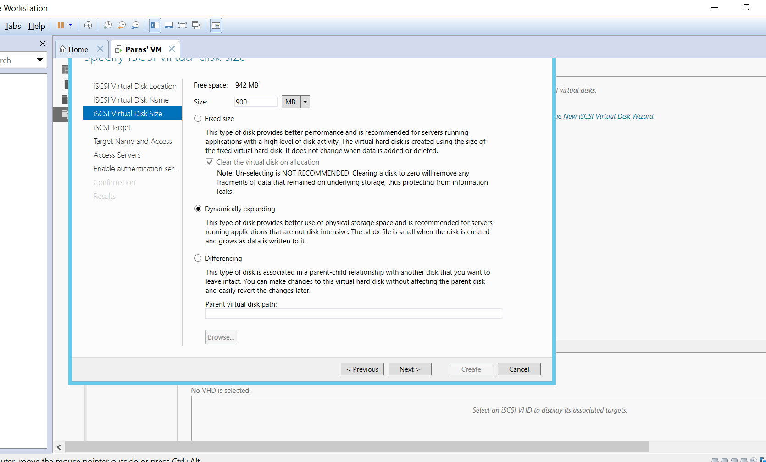
There are three types of iSCSI virtual disk, but in this case
we choose Differencing type

Slide 16
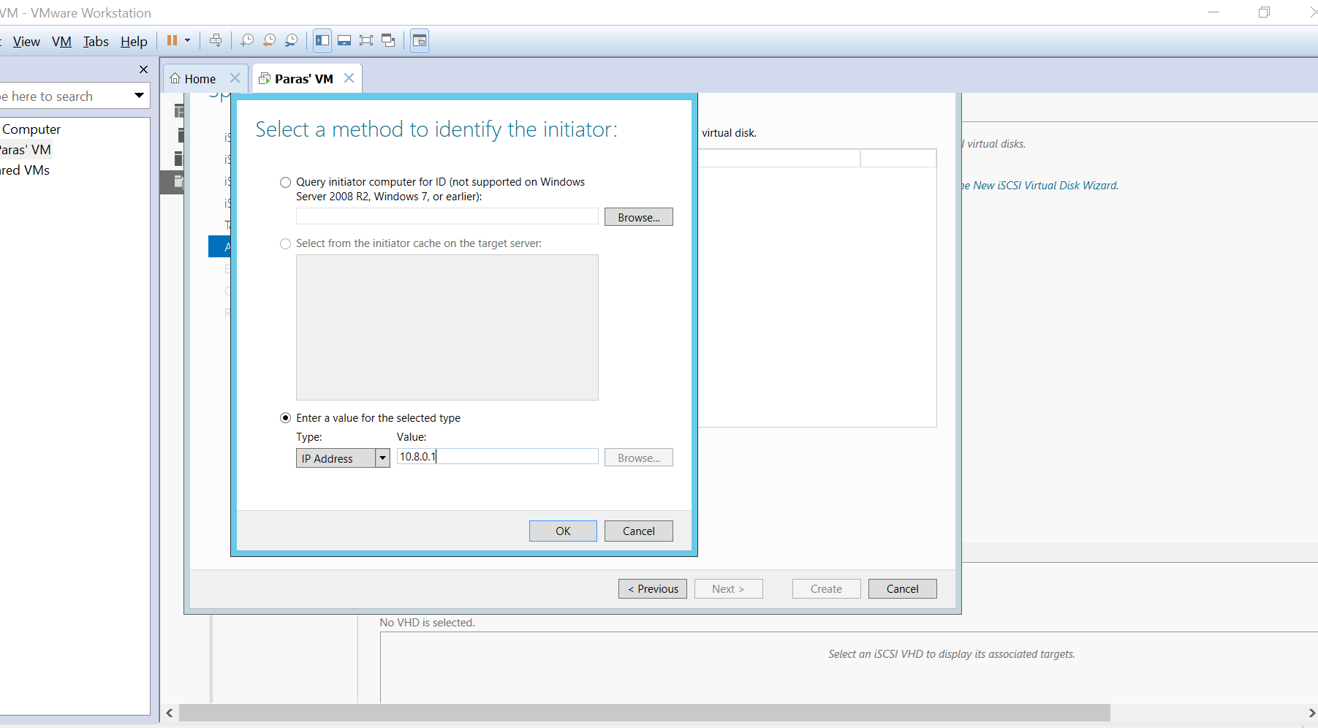
Initiator is identified by usage of IP address selected as shown
( Can be identified by IQN, Mac Address as well)

Slide 17
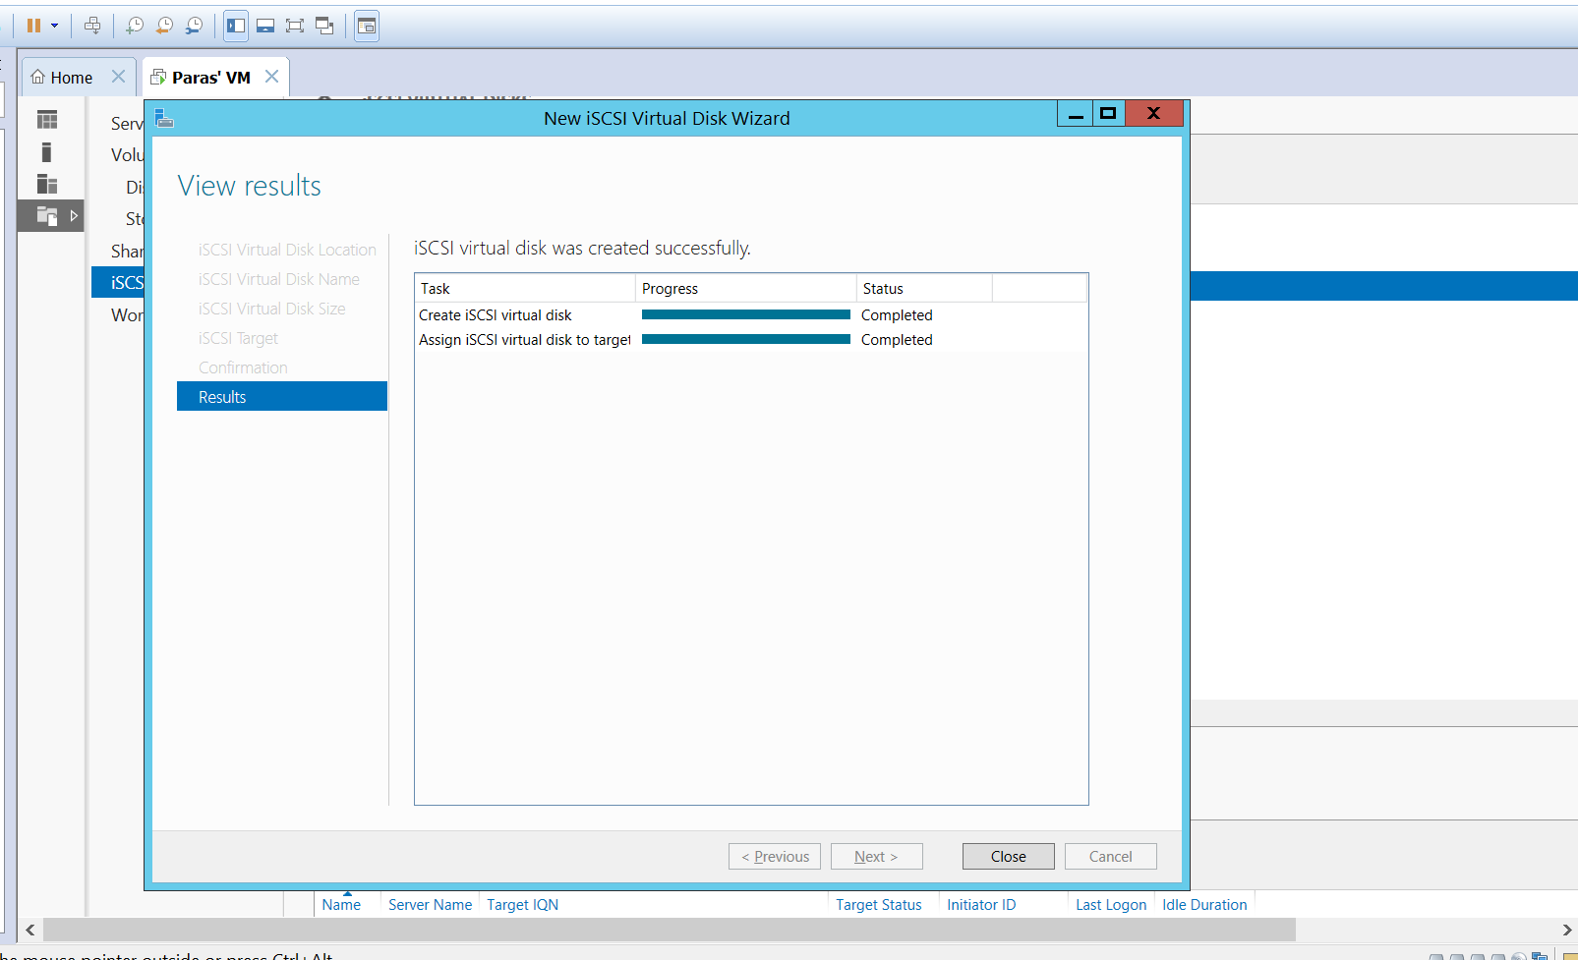
iSCSI virtual disk has been created on Target

Slide 18
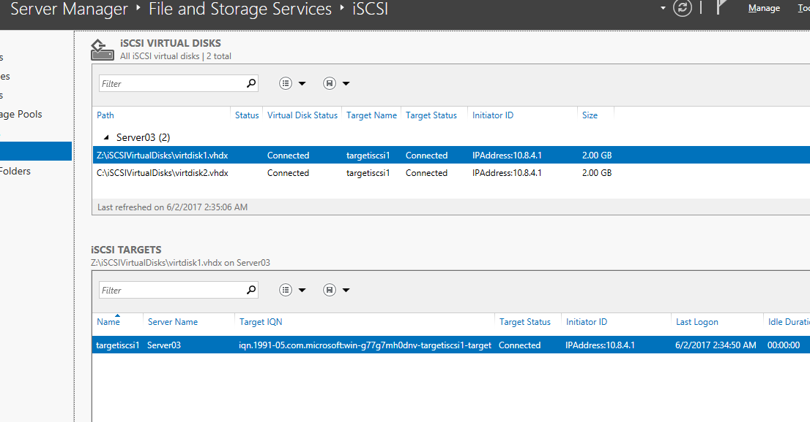
Two virtual hard disks are created (Step 3 Requirement)

Slide 19
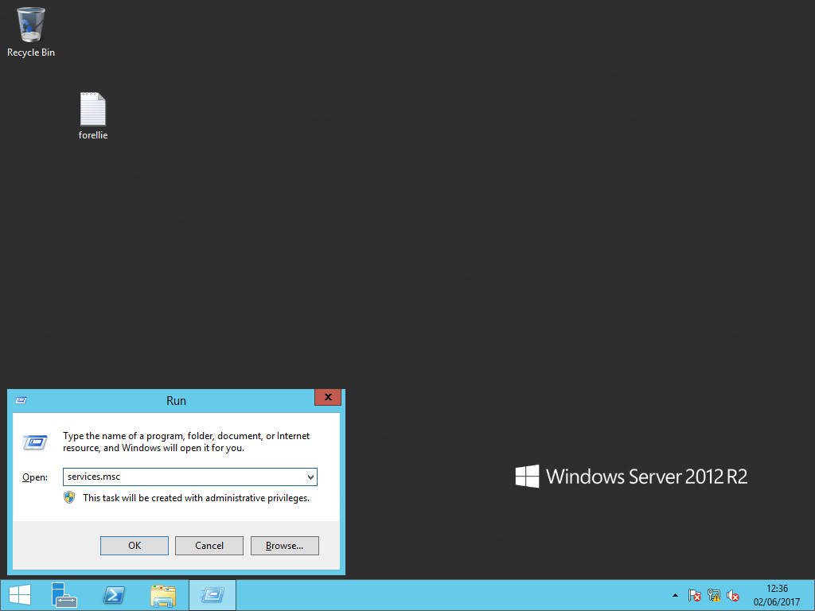
B) Initiator Setup
This is run on the initiator computer

Slide 20
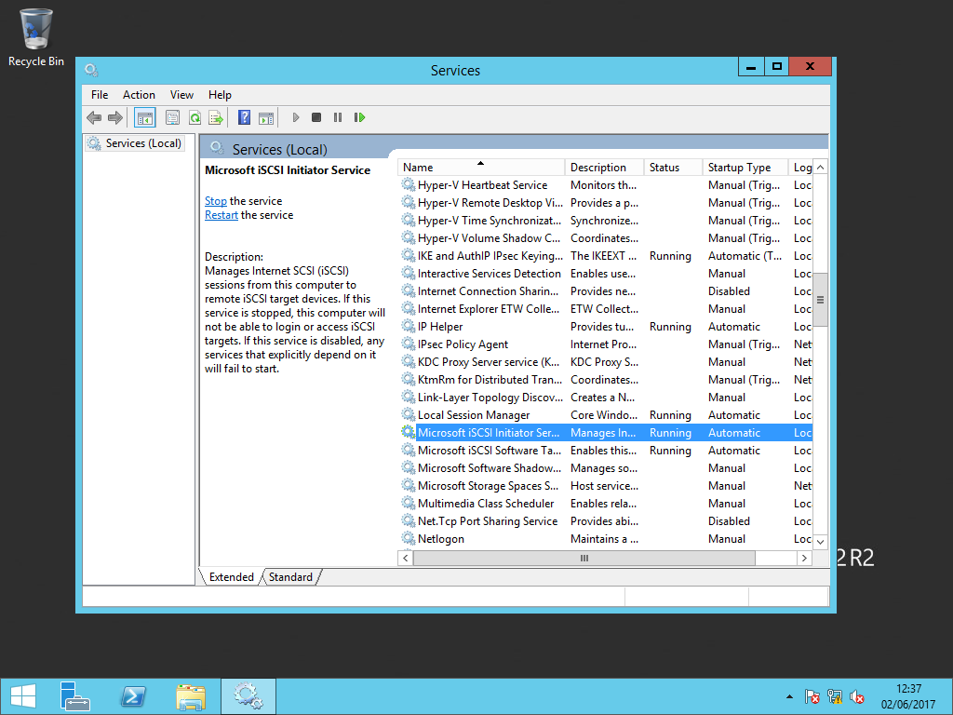
Startup Type is changed from manual to Automatic

Slide 21
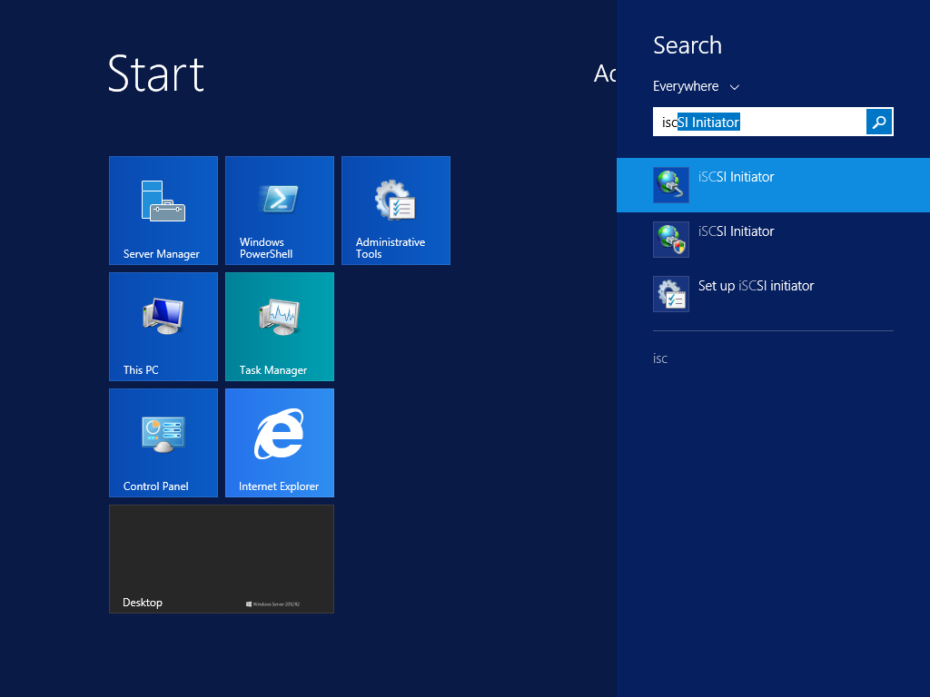
Once Microsoft iSCSI Target Server is running, search for
iSCSI Initiator

Slide 22
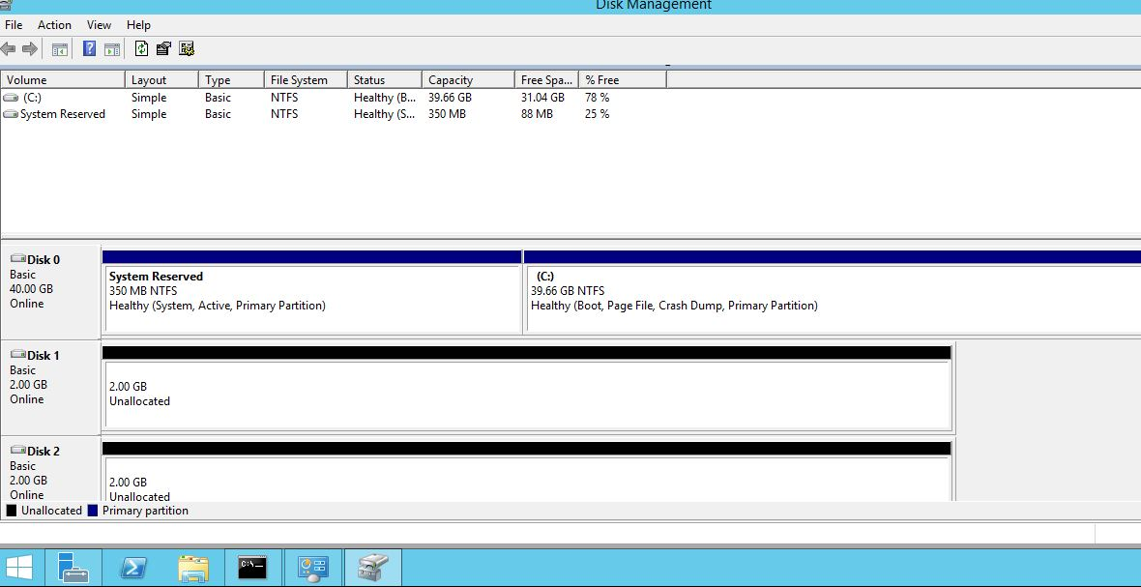
Go to diskmgmt.msc to see the vhds from target that are connected
As per Step 3, Two vhds are created

Slide 23
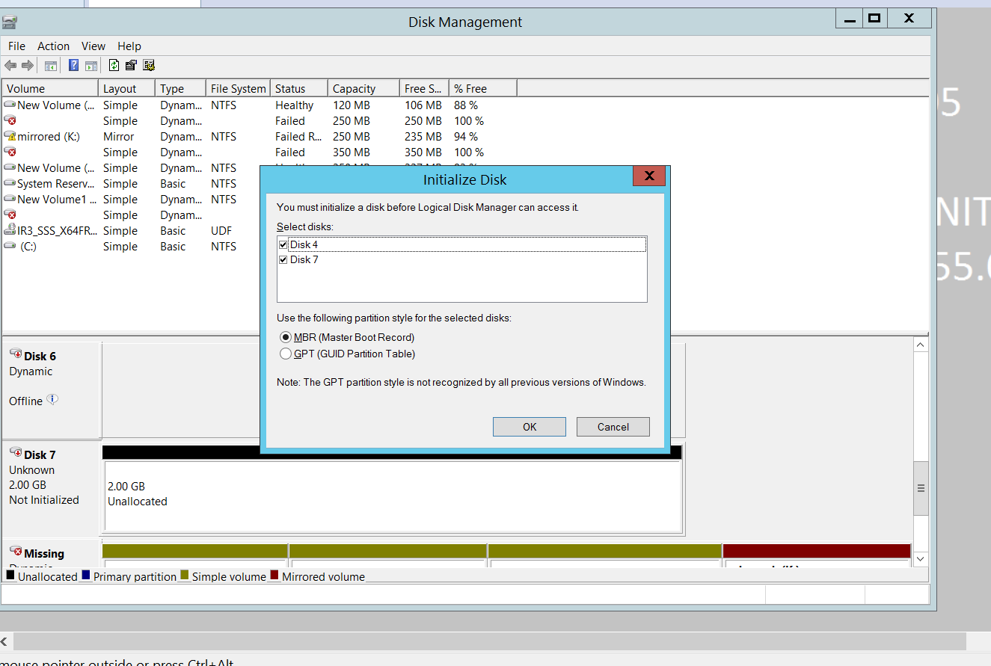
Step 4: Mirror volume to be created using both vhds
First, Initialise the two vhds

Slide 24
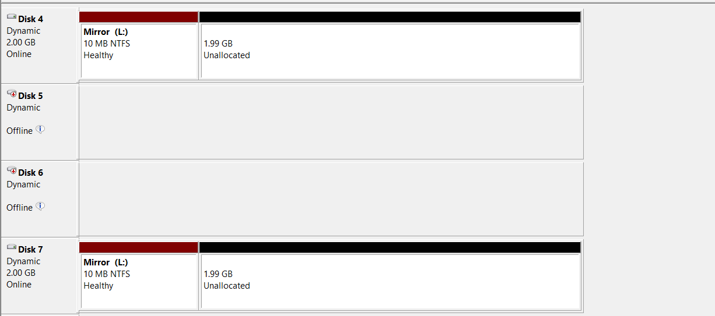
New mirror volume with the two vhds (Disk 4 and Disk 7)
has been created

Slide 25
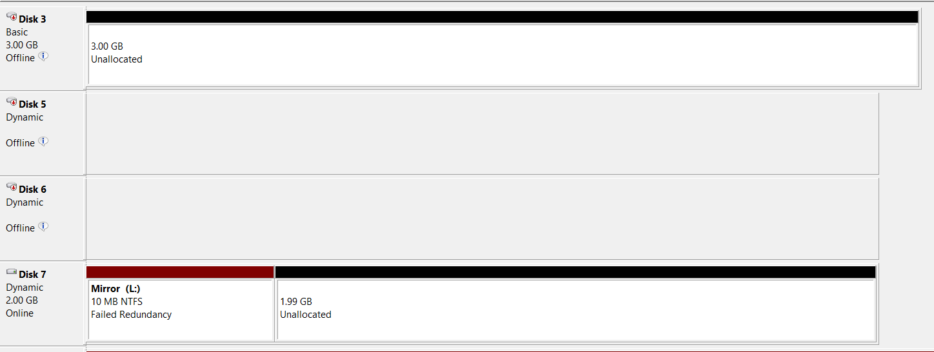
One of the vhds (Disk 4) has been removed,
Failed Redundancy is shown under Disk 7

Slide 26
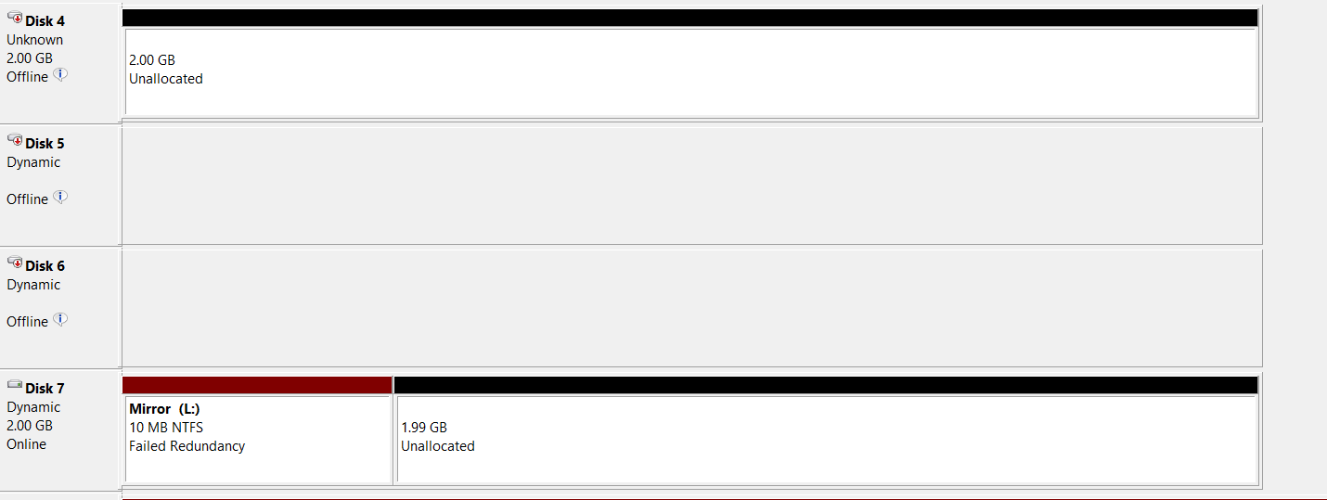
New vhd is again added from Target

Slide 27
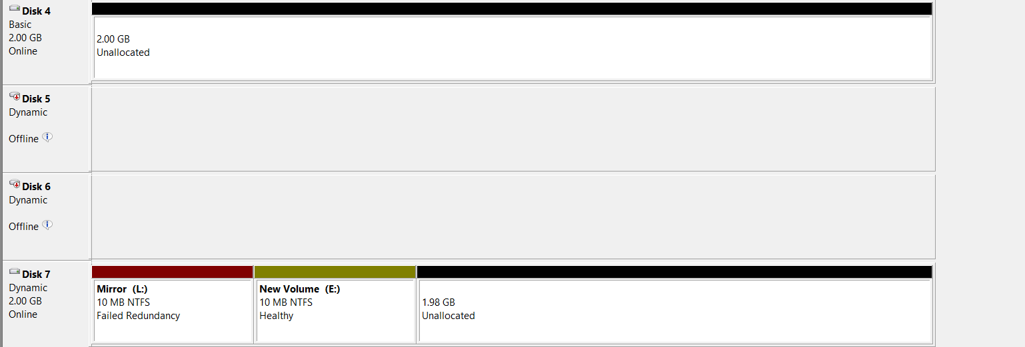
New vhd is initiated

Slide 28
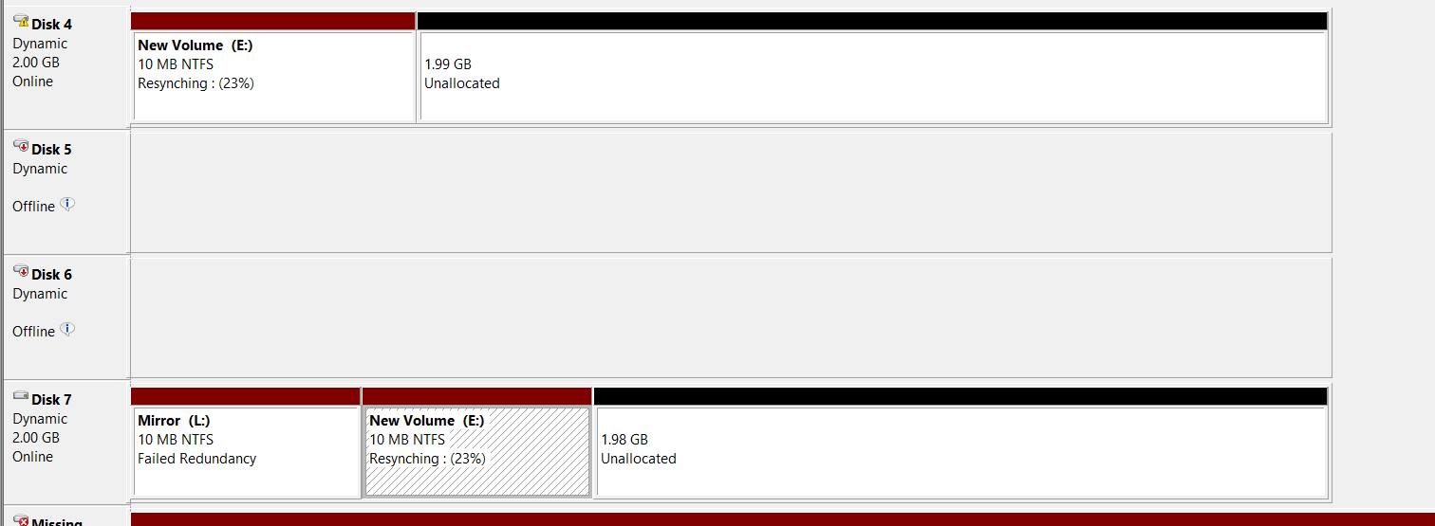
Mirrored volume is created again, to allow
Resync to be possible

Slide 29
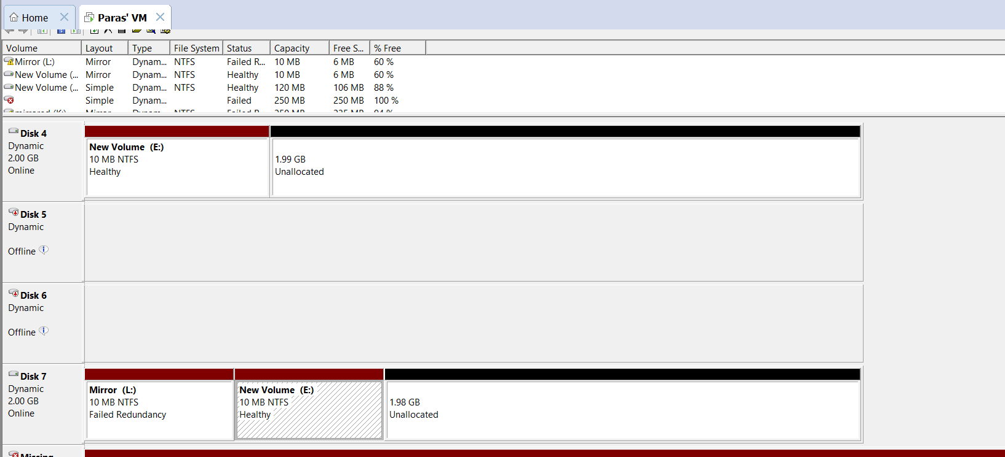
Mirror is made healthy again

